Slide 1
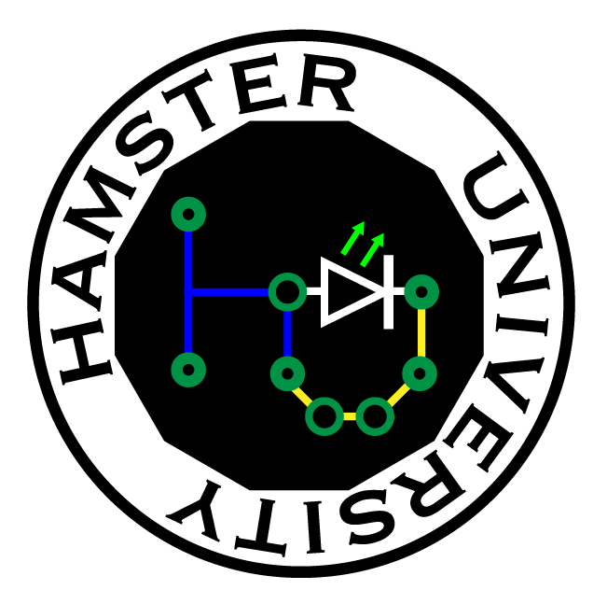
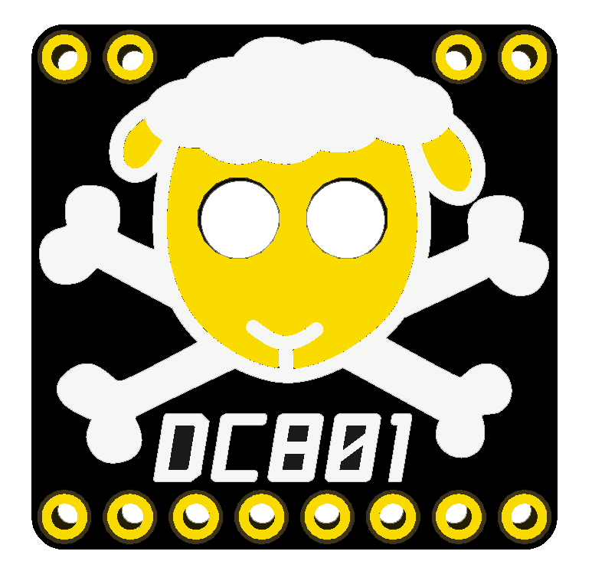
Switch Mode Power Supplies 101

Slide 2
POWER!!!
Almost every device needs power regulation
So how do you regulate power?
SMPS 101

Slide 3
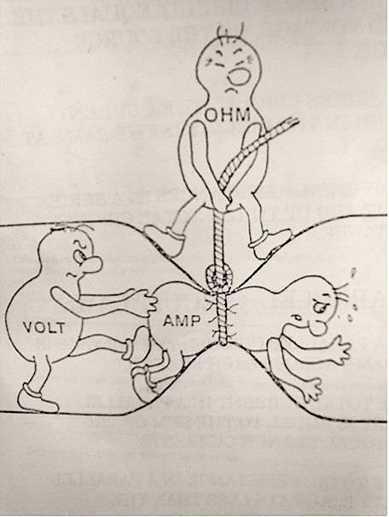
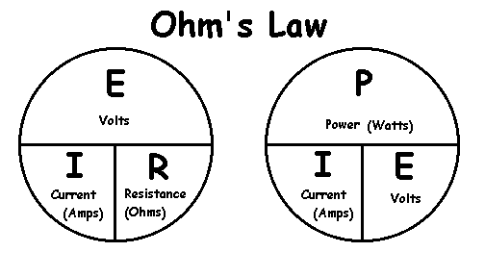
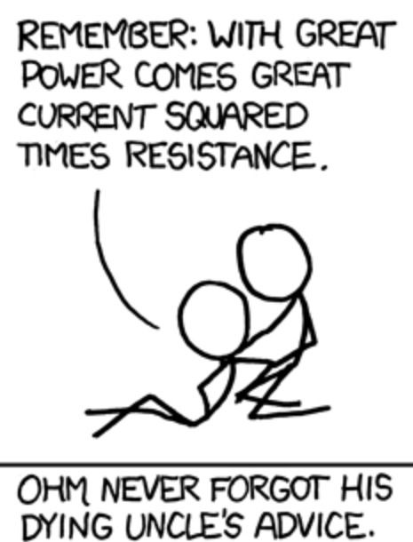
An aside – Ohm’s Law
SMPS 101

Slide 4
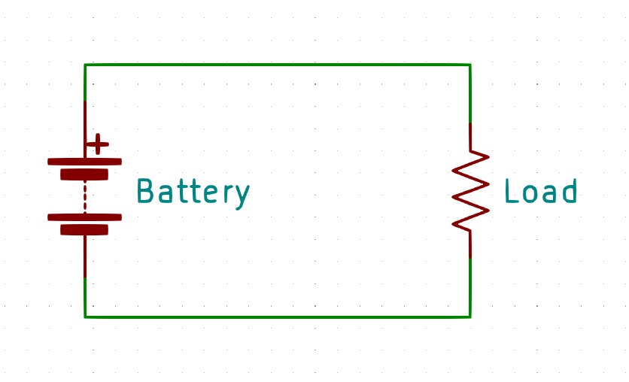
The basic – just a battery
The most basic power supply is none at all
Pick a max battery voltage and use that
Pros – Simple
Cons – No regulation. What happens when the battery discharges?
SMPS 101

Slide 5
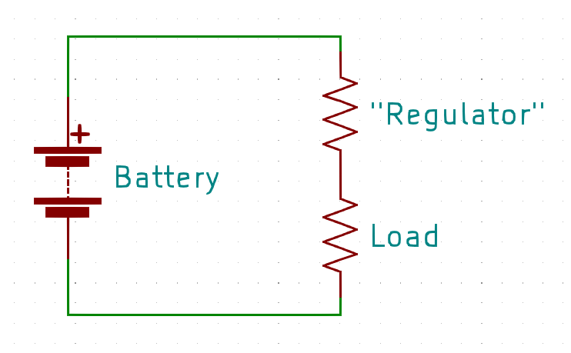
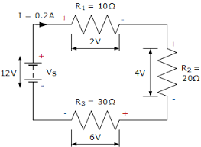
The slightly basic – a resistor regulator
Need a voltage less than that of your battery?
Pick a couple of resistors and use that
Pros – Simple, can use Kirchoff’s Law to calculate
Cons – What happens when the battery discharges? What happens if the load resistance changes? What happens if the load is drawing a lot of power?
SMPS 101

Slide 6
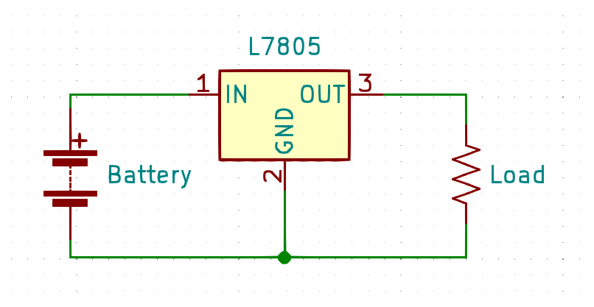
Regulations – a linear regulator
Need an exact voltage?
Grab a linear regulator
Pros – Still simple, cheap
Cons – A linear regulator converts the excess input power into heat! Input voltage must be about 1.5V above what you want out, unless you get a ‘LDO’ (low drop-out), and then 0.3V is typical
SMPS 101

Slide 7
The switch up
So how do we transform voltage efficiently?
What if we want MOAR volts out than we have going in?
What if we want to go negative?
SMPS 101

Slide 8
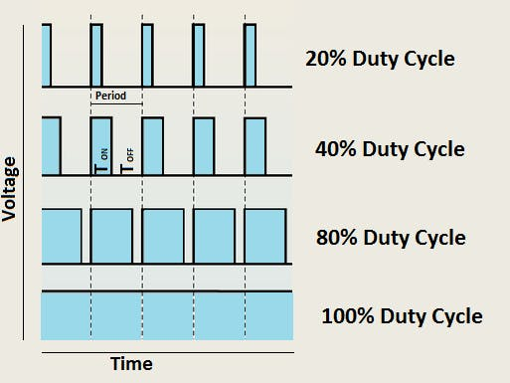
An aside – Pulse Width Modulation
PWM is toggling a switch on and off at varying duty cycle
Duty cycle is expressed in percent on time
Independent of base frequency!
SMPS 101

Slide 9
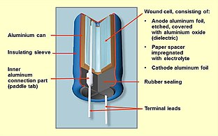
An aside – Capacitors vs Inductors
Capacitor
Stores charge in parallel plates Resists changes in voltage
Measured in Farads – 1 Farad = 1 coulomb at 1 volt
SMPS 101

Slide 10
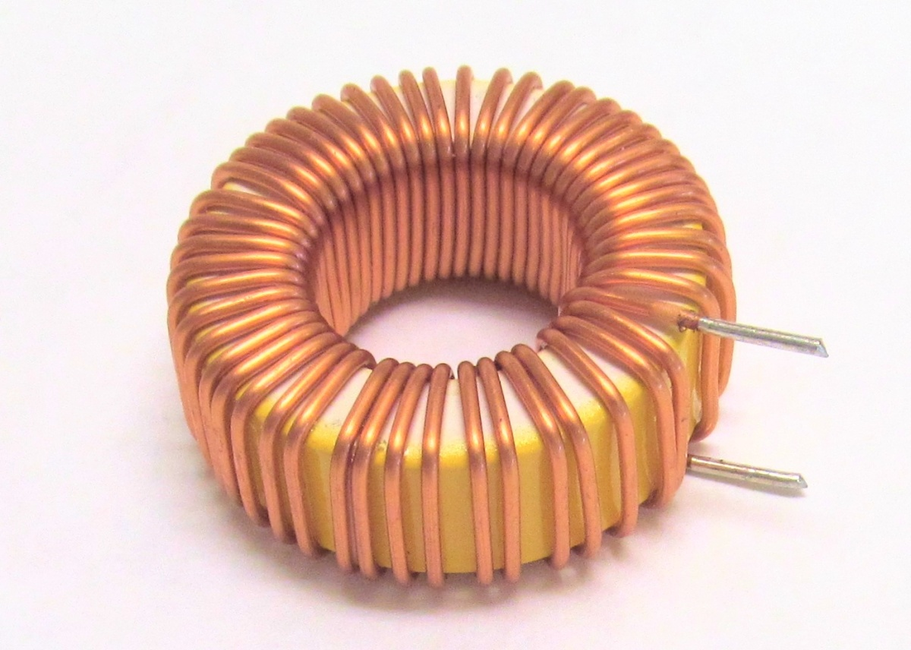
An aside – Capacitors vs Inductors
Inductor
Stores magnetic field in coil Resists changes in current
Measured in Henry – 1 Henry = 1 ampere flowing through the coil producing flux linkage of 1 weber turn (what)
‘Saturation’ is when the magnetic field is no longer rising
SMPS 101

Slide 11
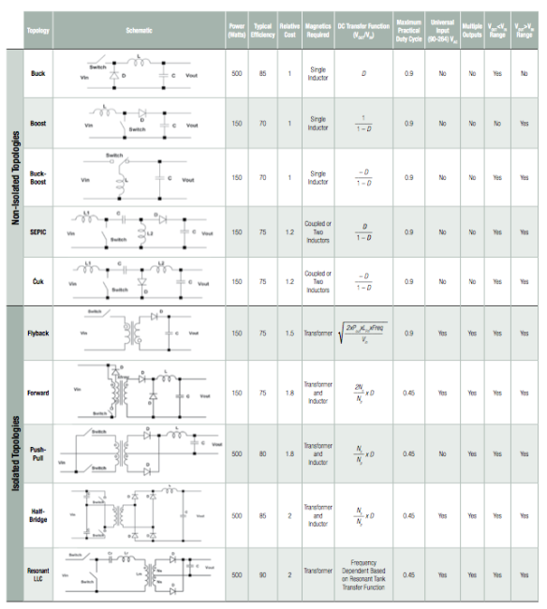
Topologies
SMPS 101

Slide 12
Topologies
… what?
SMPS 101

Slide 13
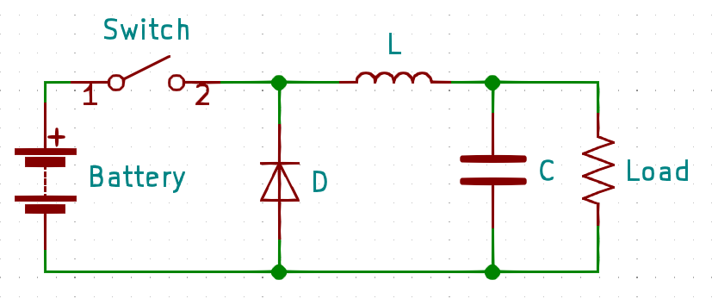
Buck converter topology
Parts:
- A switch - A diode - An inductor - A capacitor
SMPS 101

Slide 14
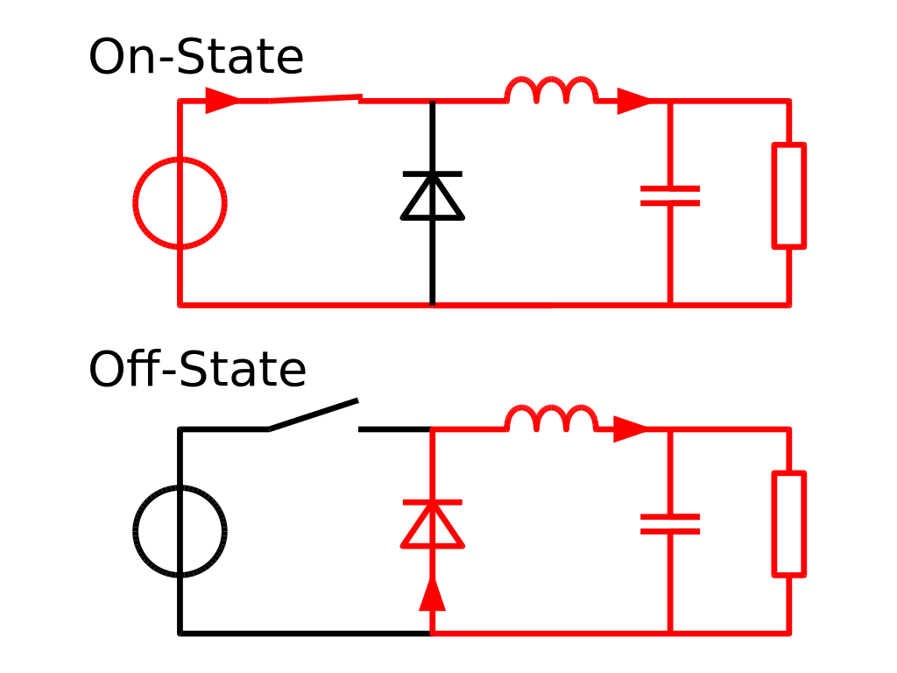
Buck converter operation
Theory of operation
Only want some of the power? Just sip from the firehose!
On State – Directly connected to load. As soon as the output voltage hits the limit, turn it off.
Off State – The capacitor ‘tanks’ voltage, the inductor ‘tanks’ current – for a short while
The diode completes the circuit when the switch is open
SMPS 101

Slide 15
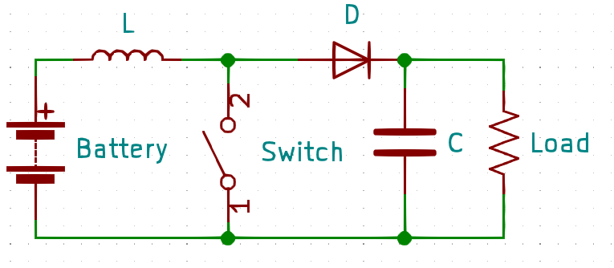
Boost converter topology
Same parts as the buck
New exciting wiring configuration
SMPS 101

Slide 16
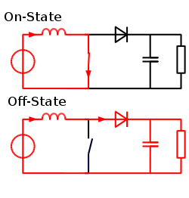
Boost converter operation
Theory of operation
Make the inductor work for you
On State – Short-circuit input into coil to build magnetic field (be mindful of saturation!)
Off State – As the magnetic field in the inductor drops, it increases the voltage to keep the current through it stable. The diode prevents back leakage.
No load = output voltage going to the moon
SMPS 101

Slide 17
Other topologies
Buck/Boost – a bit of both
Ćuk – (chook) a Buck/Boost but negative output
Flyback – Isolation of input/output via transformer
Many, many variations…
SMPS 101

Slide 18
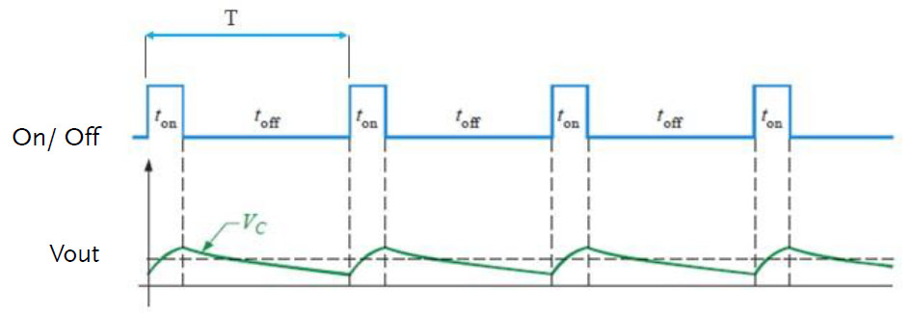
Output Ripple
Ripple in output is gonna happen
More output C, lower ripple
Faster switch, smaller bites, lower ripple
High frequency can generate RF noise, or mess with clocks on your microcontroller
SMPS 101

Slide 19
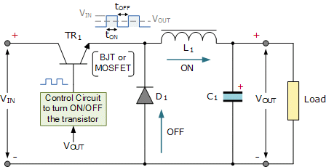
Control
Switch is actually a transistor (surprise!)
Controller can be ‘open loop’ or ‘closed loop’
Open loop is not common
SMPS 101

Slide 20
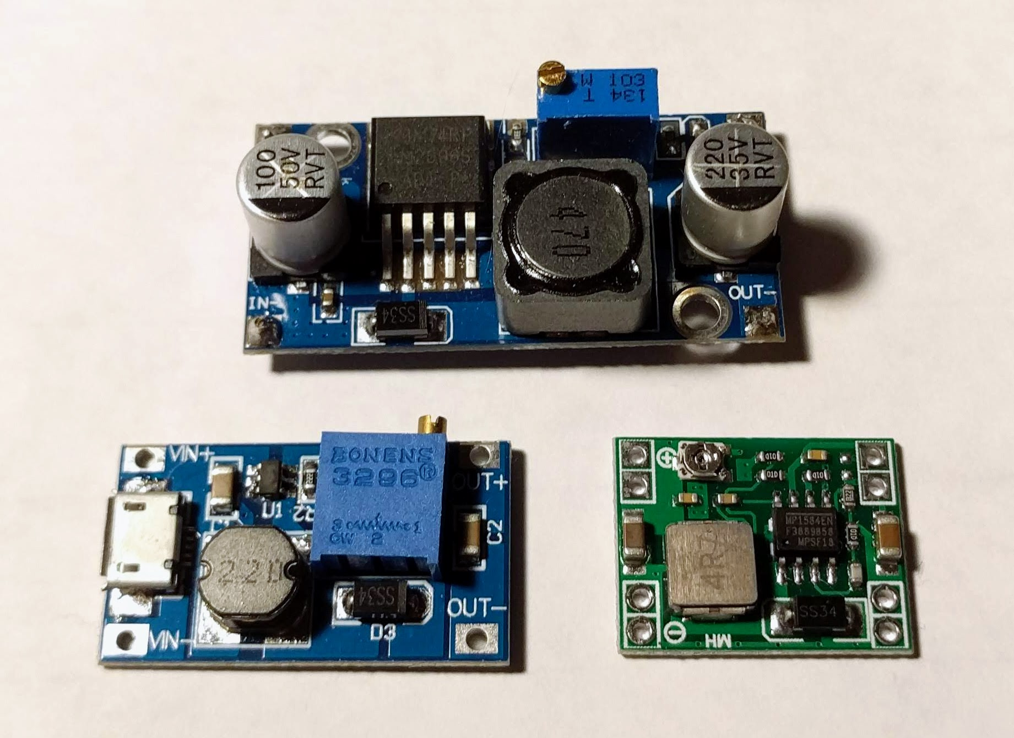
Control
Controller can be a dedicated chip
Or a 555 timer with a feedback element
Or a microcontroller
Or a monkey with a push button
PID, open loop, other methods
SMPS 101

Slide 21
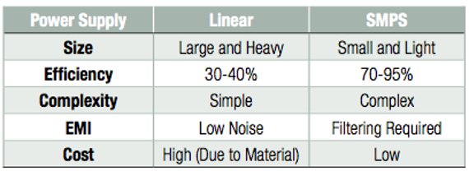
Efficiency
SMPS 101

Slide 22
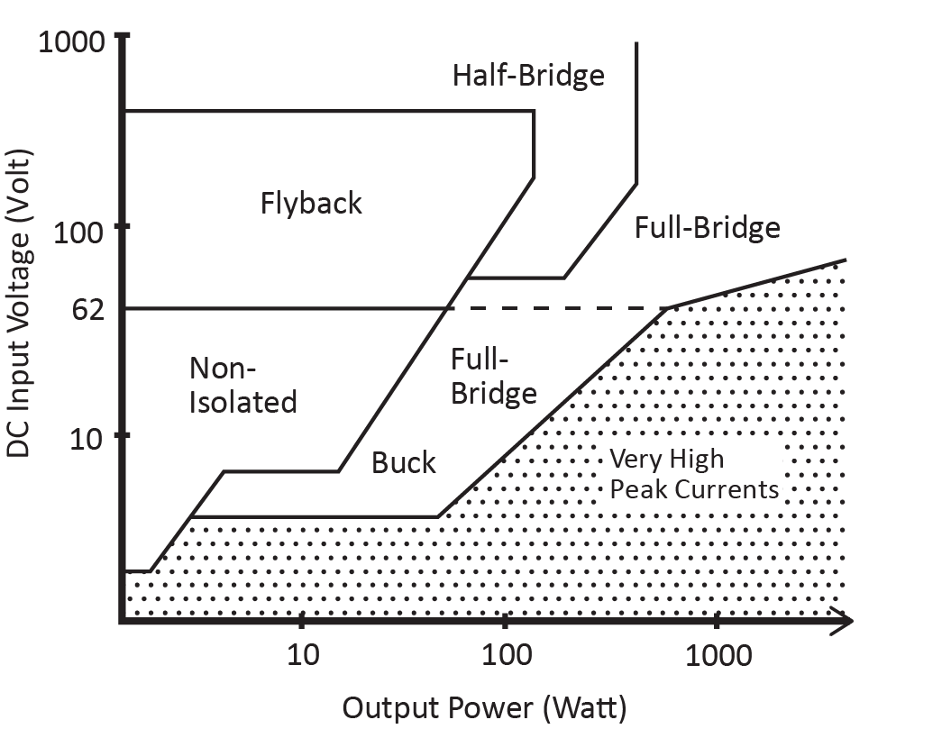
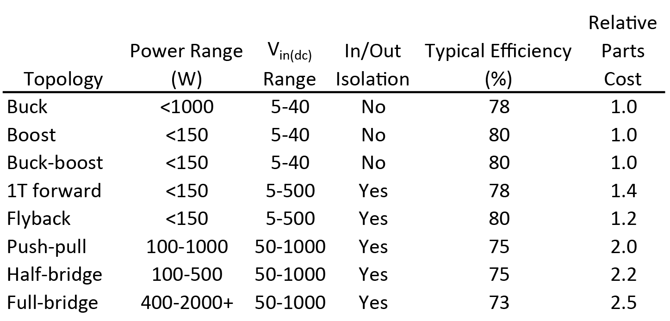
Topology selection guide
https://electronics.stackexchange.com/questions/299435/pros-and-cons-between-smps-switched-mode-power-supply-and-heavy-line-frequency-t
SMPS 101

Slide 23
Questions?
@hamster
github.com/hamster/classroom
SMPS 101

